Slide 1
Mapping Milestones
Lynne Meyer, PhD, MPH
August 24, 2022

Slide 2
What are MILESTONES?
The definition of expected outcomes
Milestones show developmental progression
Milestones should enable the trainee, program, and the certification board to know an individual’s progression in acquiring competence

Slide 3
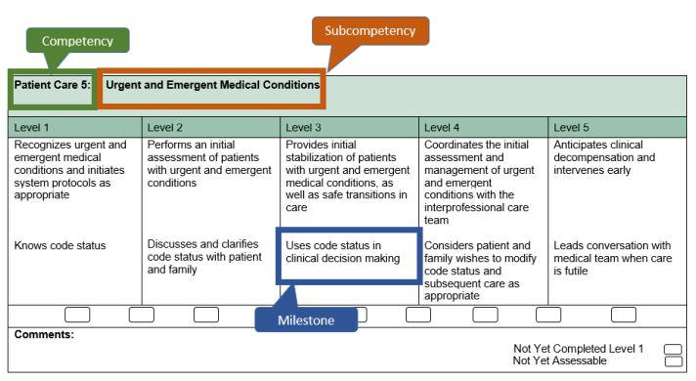
MILESTONES: Milestones are simply a significant point in development. They can enable the learner and the program to determine individual trajectories of professional development in narrative terms..
Competency
Sub-Competency
Progression Levels
Milestones

Slide 4
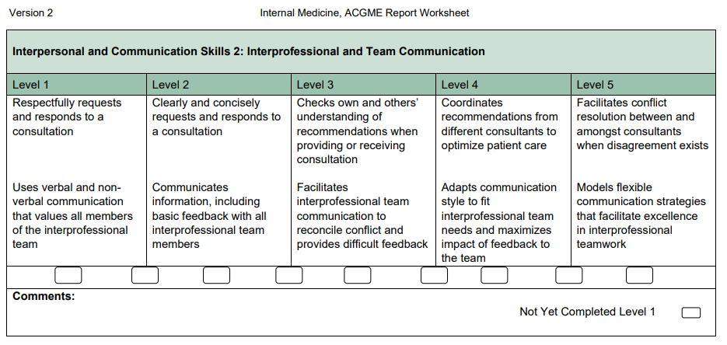
What is the Competency?
Interpersonal and Communication Skills
What is the SubCompetency?
Interprofessional and Team Communication
What is a milestone?
Coordinates recommendations from different consultants to optimize patient care

Slide 5
Milestone Mapping

Slide 6
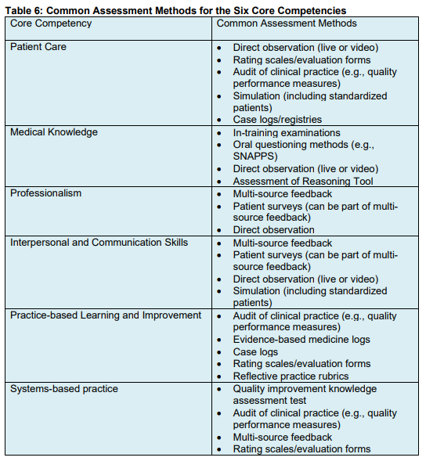

Slide 7
IM Sample: Grid
Rotation / Experience | Objectives | Subcompetencies | Evaluation Tools/Methods | Evaluation Questions
In-Patient | Communicate effectively with the healthcare team regarding emergent or scheduled procedures through conversations and writing of consult notes | ICS2 | End of Rotation Evaluation 360 Nursing & 360 Peer | Appropriately consulted attending physicians regarding diagnostic procedures The fellow communicated effectively with all health care team members
In-Patient Continuity Clinic | Provide informed consent for procedures | ICS1 | 360 patient | Explained my situation and testing options at a level I can understand
Interpersonal and Communication Skills 1: Patient- and Family-Centered Communication
Interpersonal and Communication Skills 2: Interprofessional and Team Communication
Interpersonal and Communication Skills 3: Communication within Health Care Systems

Slide 8
Process
Goals and Objectives (Curriculum) + Evaluation Forms/Methods developed at same time
e.g. QI Curriculum and QI Project Evaluation Form, In-Patient Curriculum and Rotation Evaluation for each PGY level
Curriculum/Goals and Objective & Evaluation Forms/Data Mapped to Milestones Document
E.g. end of rotation evaluation forms and corresponding curriculum to milestones document; In-Training Exam to medical knowledge; case logs to patient care,
Grid Developed to show what subcompetencies are linked/mapped to what rotations/experiences
Look for areas where there may be gap (are there subcompetencies where data is not available)
Determine how to fill in the gaps
CIRCLE BACK TO STEP 1 IF NEEDED…….

Slide 9
Milestone Mapping – Who Does What?
Task | Responsible Personnel
Writing Goals and Objectives | PD/Faculty
Developing evaluation forms that are reflective of goals and objectives (Do NOT place milestones tables in evaluation forms) | PD/Faculty
Mapping Milestones to goals and objectives and their evaluations | PD/Faculty
Uploading, Formatting, Inputting in NI | Program Coordinator
Distributing Goals and Objectives & Evaluations | Program Coordinator
Generating Reports/Data from NI based on Evaluations | Program Coordinator

Slide 10
The Milestones Guidebook
https://www.acgme.org/globalassets/milestonesguidebook.pdf

